Slide 1

A/B Testing: Case Study
DATA ANALYTICS | IRONHACK

Slide 2



IRONHACK BOOTCAMP
Agenda
A/B Testing
Business Case Scenario
Credit: Unsplash

Slide 3

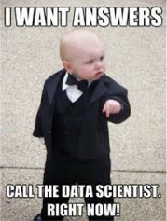
Understand
A/B TESTING

Slide 4
IRONHACK BOOTCAMP
BUSINESS CASE Scenario
You are a newly hired junior analyst
An experiment was designed as an A/B test with a measurement period of 3/15/2017 – 4/30/2017
The experiment is a digital experiment on a website that your company uses
The users/customers go on the website to register for the company’s services
Data is available at your disposal. Understand the data, hypothesis tested, and the business objectives.
Analyse the data and answer the business problems.

Slide 5
IRONHACK BOOTCAMP
Hypothesis & Objectives
Hypotheses:
A more modern UI and prompts would make clients feel more comfortable with the process
Clients would complete the new process at a higher rate
Objectives:
Analyze the ways in which clients interact differently with your product.
Measure the impact of the new process perform. What are some differences?

Slide 6
IRONHACK BOOTCAMP
Available Data
Data set 1 (df_final_demo) contains client demographic information
Data set 2 (df_final_web_data) contains web hit level web activity (split into 2 parts: pt_1 and pt_2)
Data set 3 (df_final_experiment_clients) contains a list of clients and indicates whether they were a part of the experiment

Slide 7


